Slide 1
Food preparation with recipes

Slide 2

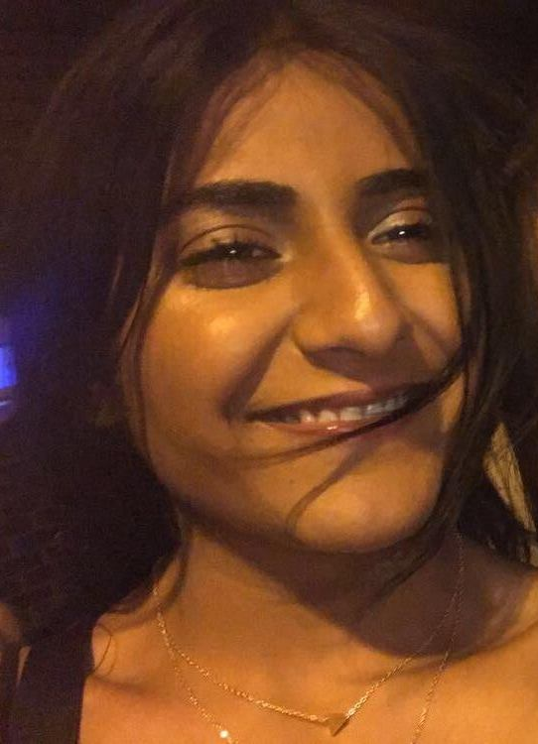
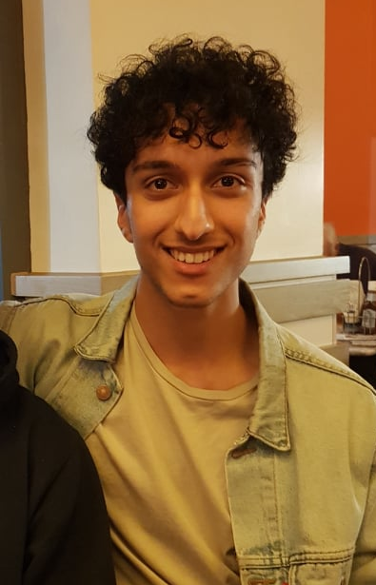
INTERVIEW PROCESS
In Person
Skype Video Call
Phone interview
Jack Wilson
Valisha Nandha
Reza Sheik

Slide 3
Interview Questions
Do you follow a certain diet, like being vegetarian, vegan or not eat specific foods?
How many meals do you prepare in a day?
What challenges do you face when cooking?
How do you decide on what to eat?
How often do you prepare your own food as opposed to going out to eat, in a month?
How important is the nutritional value of the food you eat, and why?
Any specific cultural food you like the most?
What are some of your favorite ingredients to cook with and why?
Where do you look for recipes?
Do you think your cooking skills can improve with the help of using more recipes?

Slide 4
Do you follow a certain diet, like being vegetarian, vegan or not eat specific foods?
"Yeah, I do follow a specific diet, but it doesn’t follow one of the labels. I try to eat less meat and cut back on saturated fats and things I find unhealthy. But I wouldn’t consider myself vegetarian."
"Sometimes I am vegan and sometimes I am vegetarian and sometimes I eat meat."
"I am a vegetarian. "

Slide 5
How many meals do you prepare in a day?
"I don’t know I can have 5 and sometimes I can have 1. Today I have had 3 already. Anywhere between 1 to 5."
"2 to 3 meals within a day."
"3 meals."

Slide 6
What challenges do you face when cooking?
"I rush everything because I feel like if I don’t rush everything something bad will happen. I must do everything in a certain order so it can finish at the same time which stresses me out, but I enjoy it. "
"Trying to find something both healthy and tasty and that doesn’t take long to make. I usually end up making something healthy quickly, but it doesn’t taste the best."
"Not having enough money for all the ingredients, I would like to put into my meals."

Slide 7
How do you decide on what to eat?
"Base it off what I think my body needs. If I exercise, I look for protein. If I have a big day, I eat porridge for energy. I try to hit my nutrition requirements but adjust it depending on my activities for the day."
"I think about meals I eat regularly and which one I want the most. A minute ago, I thought about should I eat rice or lentils."
"Go with what I am craving."

Slide 8
How often do you prepare your own food as opposed to going out to eat, in a month?
"Don’t have many takeaways or restaurants but occasionally buy meal deals or a portion of chips from a takeaway. 1 or 2 times a week."
"70% of the time I cook my own meals and the other 30% I eat out or have meals deals."
"I eat out probably on average once every 2 weeks. "

Slide 9
How important is the nutritional value of the food you eat, and why?
"It is very important because being a vegetarian you have to think more about what you are consuming. I try to look for food high in protein because I need to substitute it for meat. "
"It's very important to me. No point in buying and eating something unless it benefits me because I value my health."
"Depends on the day. On the average day it's very important. Occasionally I like to have a cheat day. "

Slide 10
Any specific cultural food you like the most?
"Italian food, I love pizza. I also do enjoy Indian and Chinese, but I don’t eat those very often. I occasionally eat Iranian food as that is my own culture but that’s only at home."
"I like having Indian, Polish and Mexican food. That’s what I enjoy eating the most."
"I like Turkish and Greek food. I also like Indian food and I like general Mediterranean food."

Slide 11
What are some of your favorite ingredients to cook with and why?
"I like using mushrooms because there are very flavorful when marinated with different herbs. I enjoy eating soya beans because they are one of the highest sources of protein for vegetarians. "
"I like to cook with tomatoes because they taste nice. I love making bacon and tomatoes sandwiches. I also like putting garlic because it reduces hypertension and blood pressure which I think is great."
"Olive oil, chili and salt. "

Slide 12
Where do you look for recipes?
"I usually observe people and take ideas from that or search up recipes on the internet."
"I don’t really look at recipes and just make things with my imagination."
"I don’t I make things up in my head. "

Slide 13
Do you think your cooking skills can improve with the help of using more recipes?
"Maybe it would open up more meals for me to be able to prepare."
"Probably."
"Yeah definitely."

Slide 14

SAID.
"70% of the time I cook my own meals and the other 30% I eat out or have meals deals."
"Sometimes I am vegan and sometimes I am vegetarian and sometimes I eat meat."​
"I also like putting garlic because it reduces hypertension and blood pressure which I think is great.
"
"I don’t (look for recipes) I make things up in my head."
"Trying to find something both healthy and tasty and that doesn’t take long to make (is challenging)."
"I love pizza."
"I enjoy eating soya beans because they are one of the highest sources of protein for vegetarians."

Slide 15
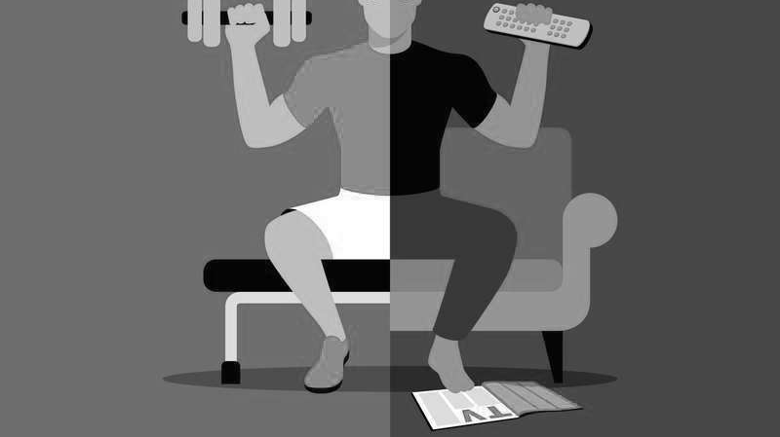
DID.
Had to spend more money on foods that are healthier for them.
Doesn't look up recipes – they use their imagination.
Looked for food in high protein to substitute for meat as a vegetarian.
They cook for them self most of the time, only sometimes goes out to eat.
Adjusts their diet for the day depending on how active they will be.
Try to eat less meat and cut back on saturated fats.
Eat food from their home country when they are there.
Changed what they eat because they are vegan/vegetarian.

Slide 16
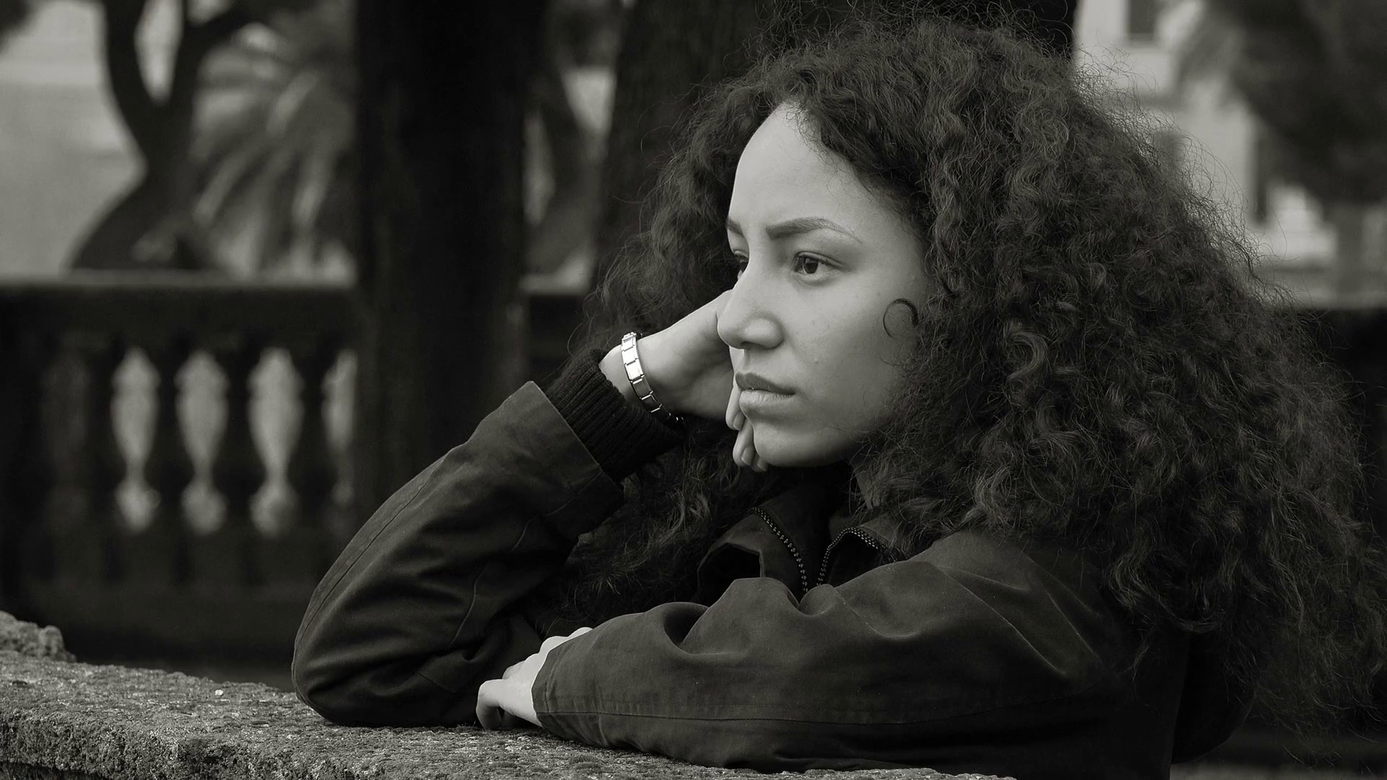
FELT.
Motivated to eat healthier.
Satisfied with their current diet.
Encouraged to try new foods and recipes.
Healthy for regularly eating healthier foods.
Embarrassed that they cannot afford the food they want.
Frustrated because they cannot cook for them self.

Slide 17
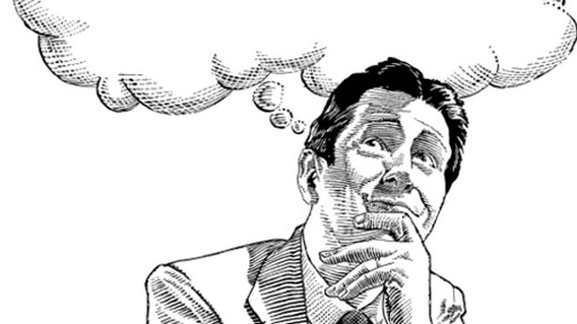
THOUGHT.
Does affordability determine what I will eat.
Where to find more recipes.
Do I spend too much on food.
How important is nutrition to me.
How many meals should I eat a day.
Which meal to prepare next.
Should I eat less meat.

Slide 18
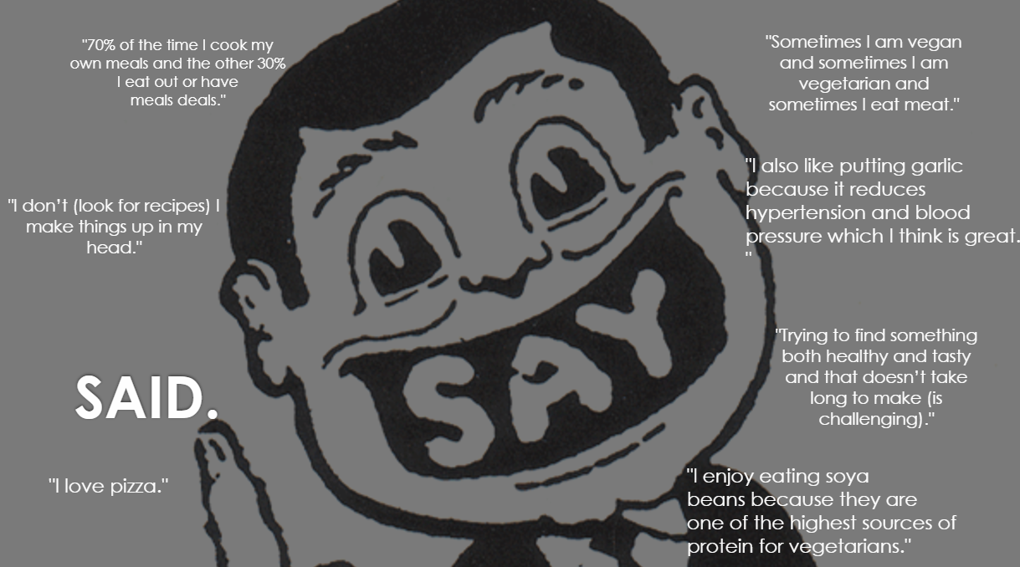
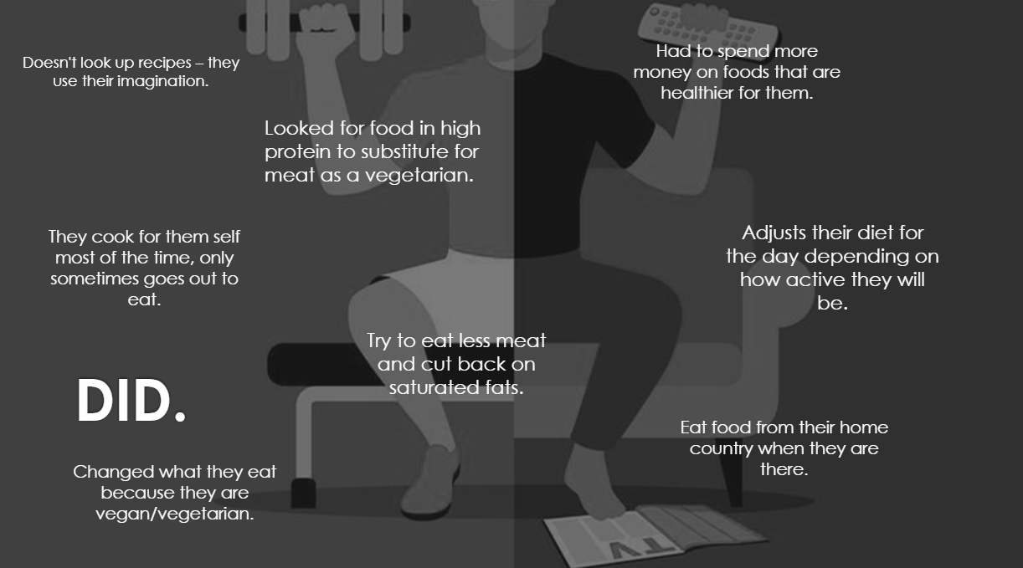
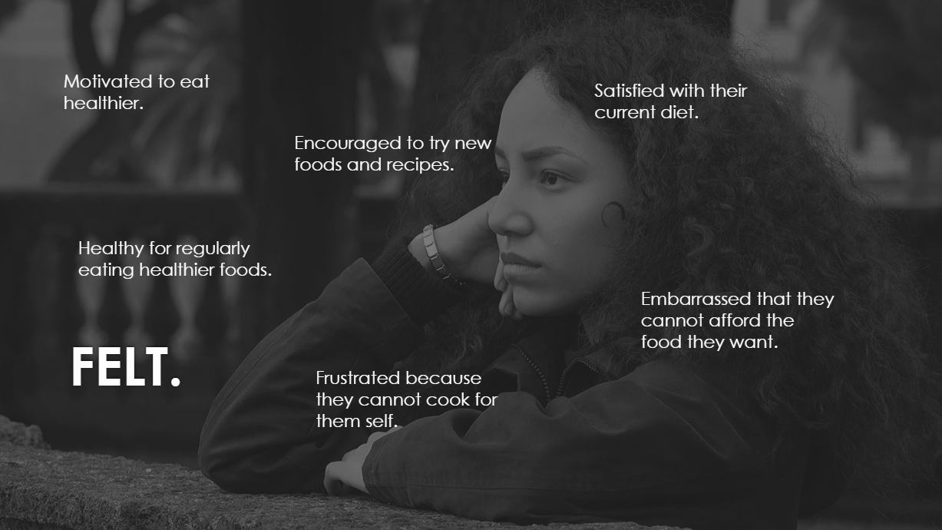
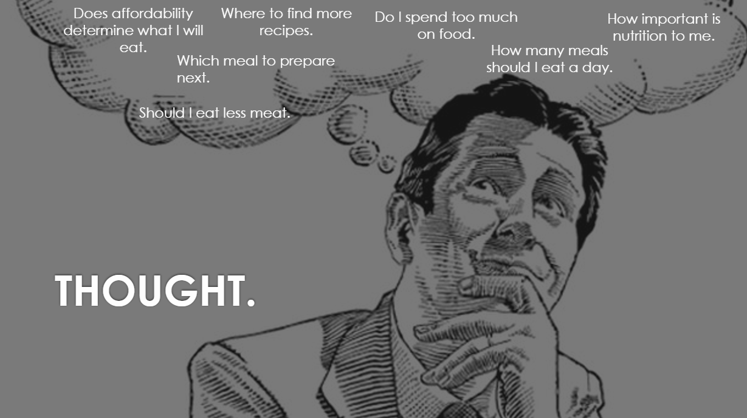

Slide 19
Things That Intrigued Us
Students felt that they cannot afford to eat healthy because of lack of income.
We were surprised that one of the students becomes frustrated because they believe they cannot cook for themselves.
A student had a number range of meals they eat a day, sometimes they would only eat once. This is a concern for their health.
One of the students would contradict themselves when asked about their diet type, their answer was that they are sometimes vegan, sometimes vegetarian and sometimes they do eat meat.

Slide 20
Point of Views
A biology student who generally uses his imagination to prepare meals but struggles with time management skills whilst preparing the food.
The young athletically driven marketing student wanted to still be able to eat healthy and cheap at the same time.
An ethical student who Is a vegetarian struggling to maintain their protein intake since they cant eat meat.
Valisha
Jack
Reza

Slide 21
How We Might
How we might do this, is by having a "nutrition rating" for recipes so she could find high protein recipes.
How we might do this, is by providing meals and recipes suitable for vegetarians and high in protein. This would cater to her dietary choice as well as help her fulfil her nutritional requirements.
How we might do this, is by having a filter for only vegetarian recipes so she could freely look through it.
How we might do this, is by including a Quorn meal section as it’s the most popular food for vegetarians.
How we might do this, is by having a filter for only protein-based recipes.

Slide 22
How We Might
How we might do this, is by filtering recipes depending on how many steps they have so it would be easier to find simple recipes.
How we might do this, is by filtering recipes by the time they take so he could find the quickest recipes.
How we might do this, is by giving recipes a "difficulty rating" so he could find easy recipes.
How we might do this, is by preparing step by step recipes, with time stamps on each step, that are simple to follow. This would help with his time management when preparing the food.
How we might do this, is by providing alternatives to ingredients within recipes so he can pick and choose.

Slide 23
How We Might
How we might do this, is by allowing the user to search by price so that he could find a recipe within his budget.
How we might do this, is by having a calorie filter so he could find the foods with the least and most calories.
How we might do this, is by giving recipes a "health rating" along with stating its total price. This would help him compare different recipes and find what is best for him.
How we might do this, is by having a price range functionality so he can choose within a certain range.
How we might do this, is by filtering food by price.

Slide 24
How We Might
How we might do this, is by incorporating vegetarian filter as no meals with has as many vegetables as vegetarian food.
How we might do this, is by having a family section so that users can quickly find big meals fit for a family.
How we might do this, is by having a filter for allergies so that users can find recipes that do not contain food that they are allergic to.
How we might do this, is by adding substitutes and suggestions into the ingredients of recipes. This way users could share what extra ingredients could be used and added, like more vegetables.
How we might do this, is by giving recipes a discussion board so that users can share their experiences of making them.
Jessica Miller

Slide 25
Top Solutions
Providing meals and recipes suitable for vegetarians and high in protein. This would cater to her dietary choice as well as help her fulfil her nutritional requirements.
Preparing step by step recipes, with time stamps on each step, that are simple to follow. This would help with his time management when preparing the food.
Recipes would get a "health rating" along with stating its total price. This would help him compare different recipes and find what is best for him.

